Slide 1
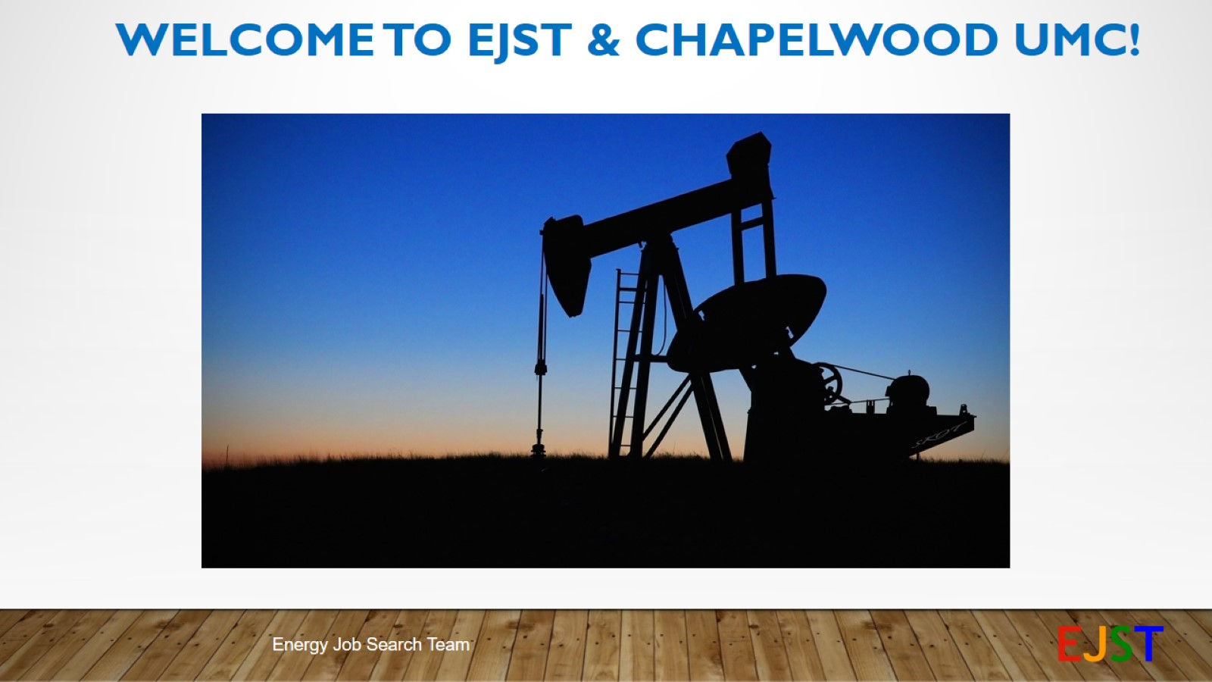
Welcome to EJST & chapelwood UMC!

Slide 2
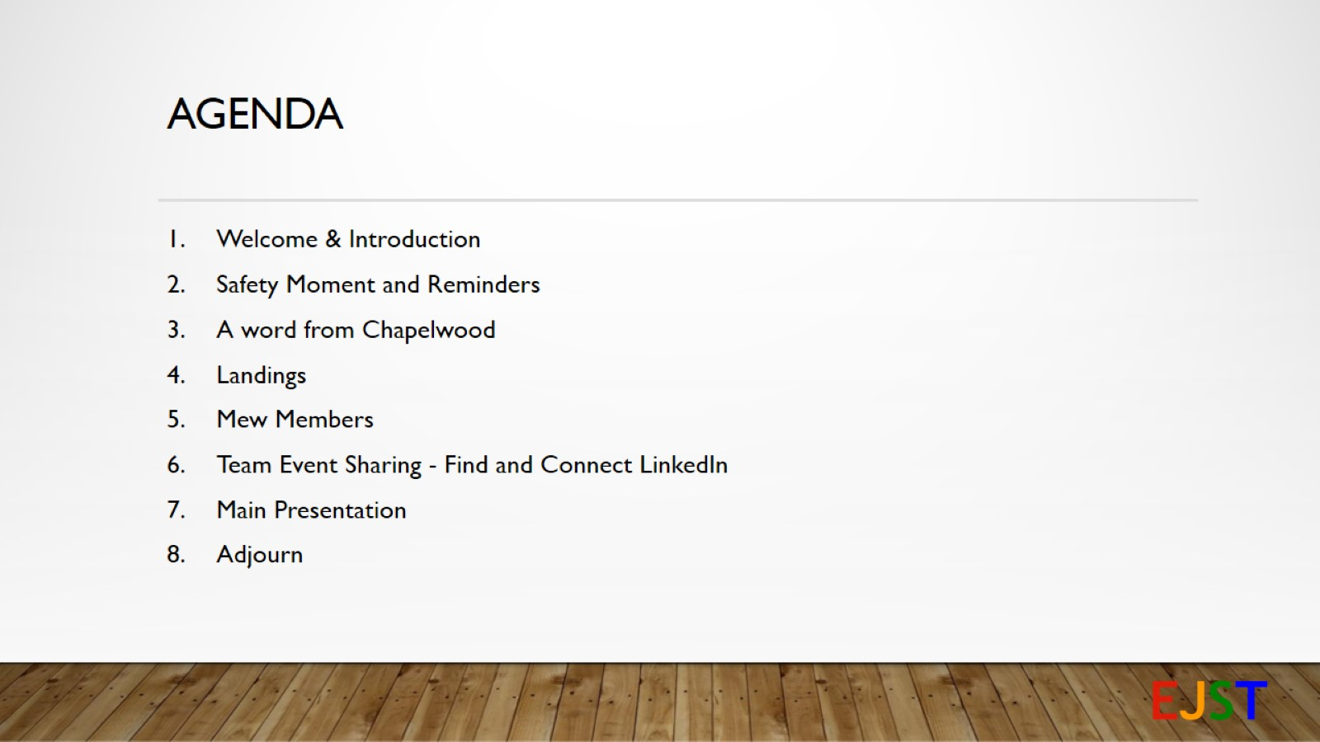
AGENDA

Slide 3
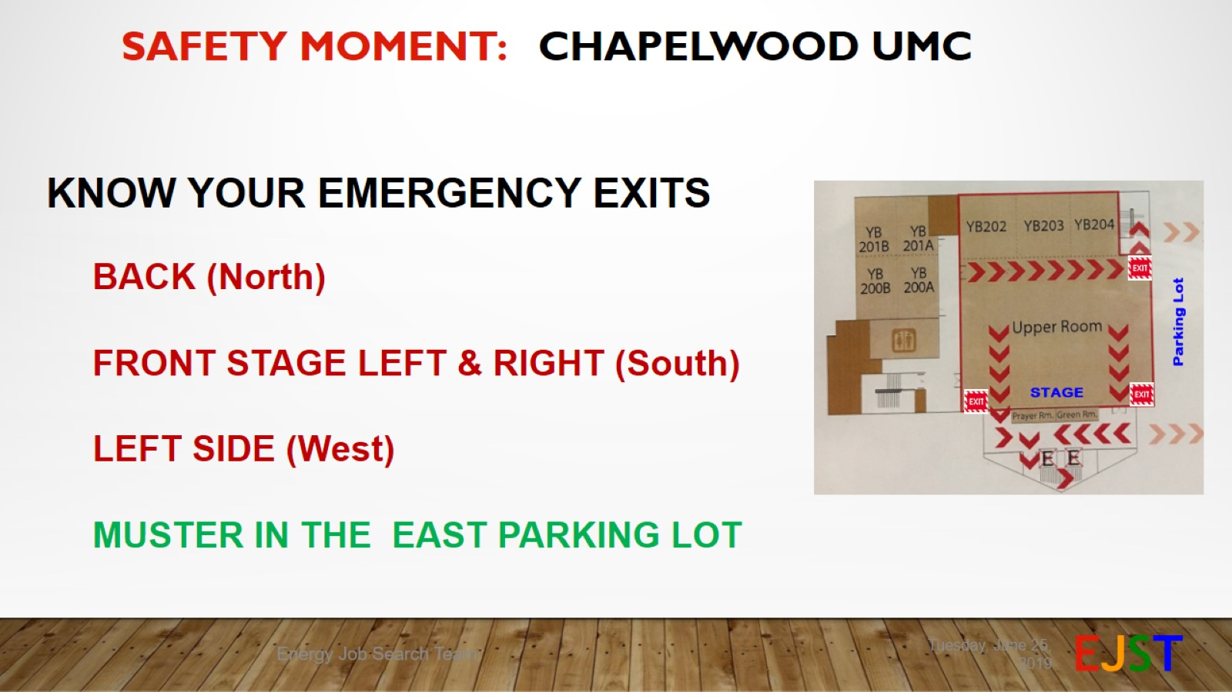
Safety Moment: Chapelwood UMC

Slide 4
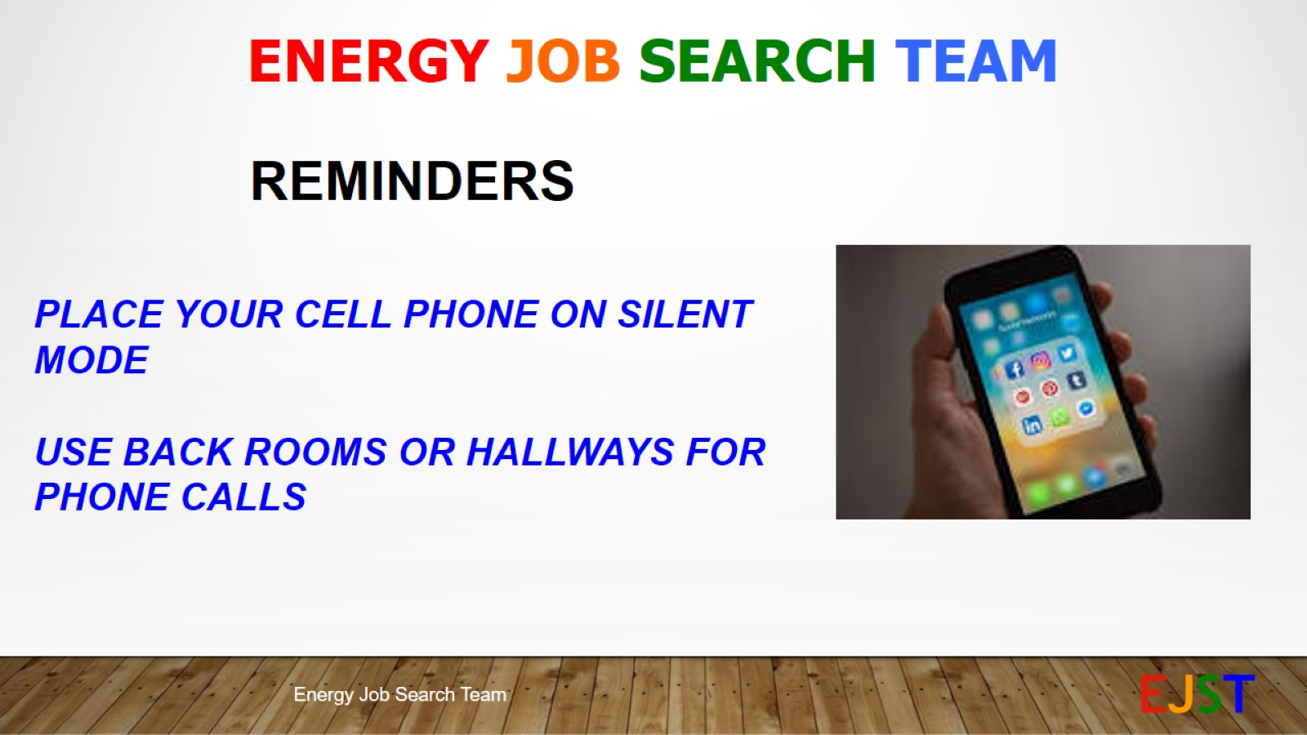

Slide 5
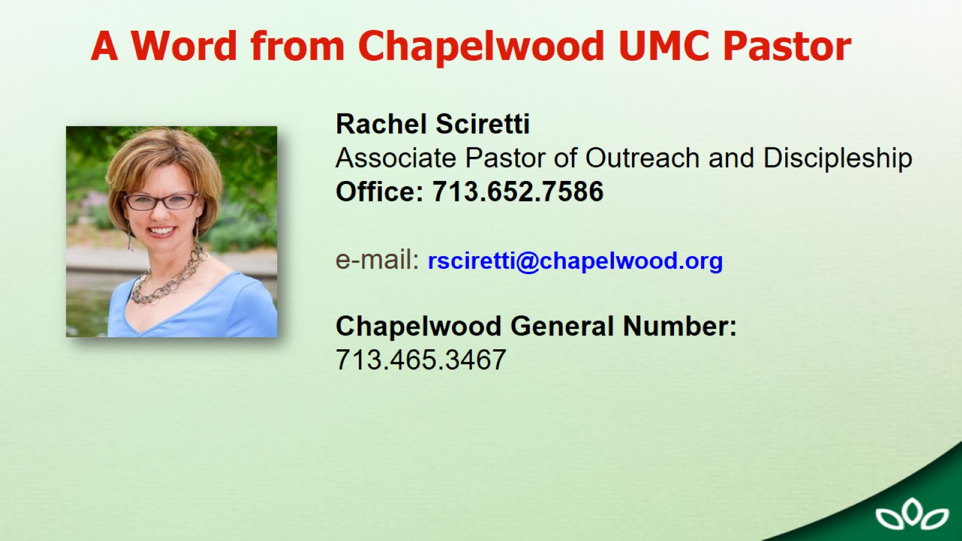

Slide 6
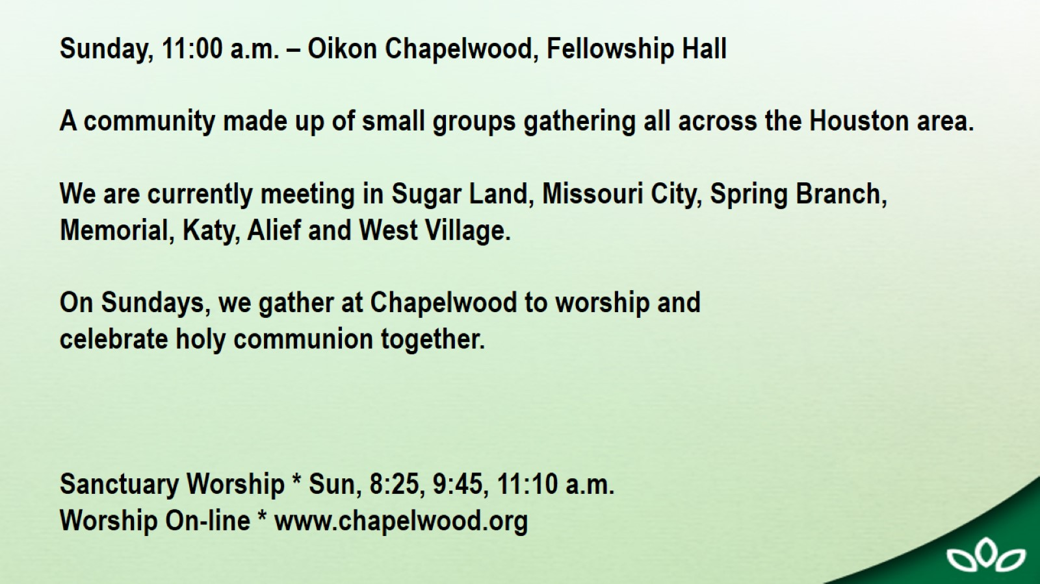

Slide 7
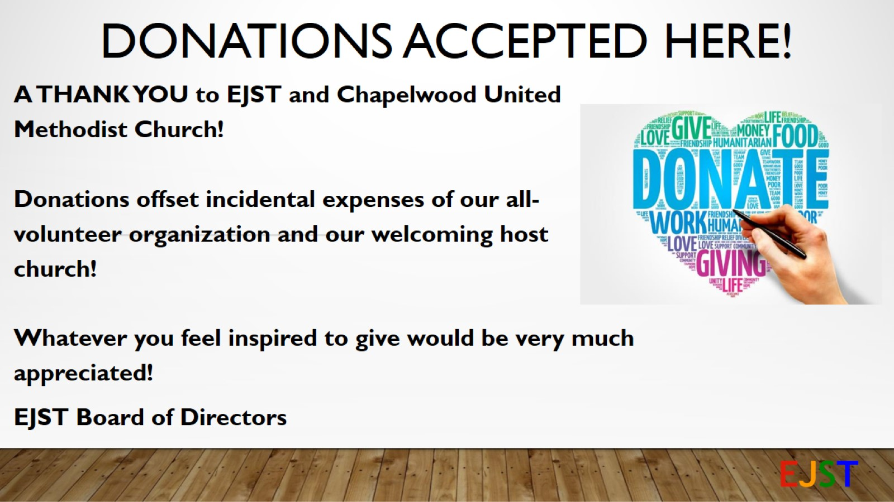
Donations Accepted Here!

Slide 8
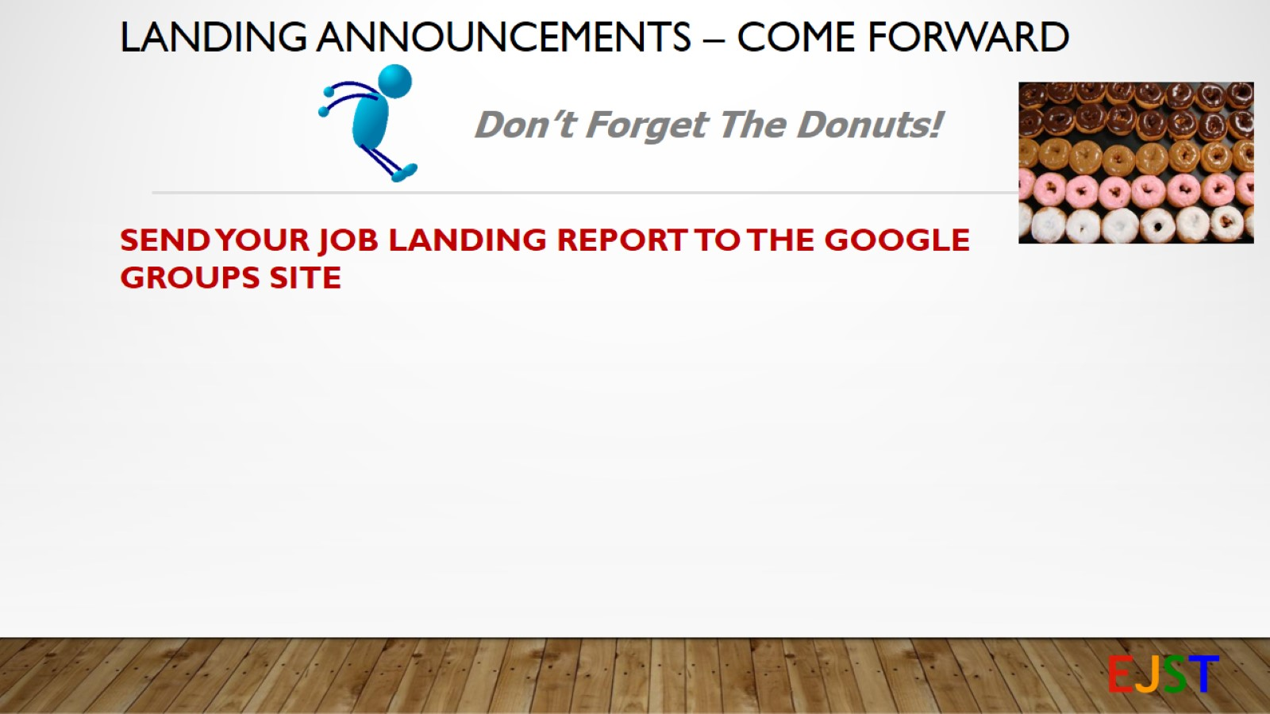
Landing Announcements – COME FORWARD

Slide 9
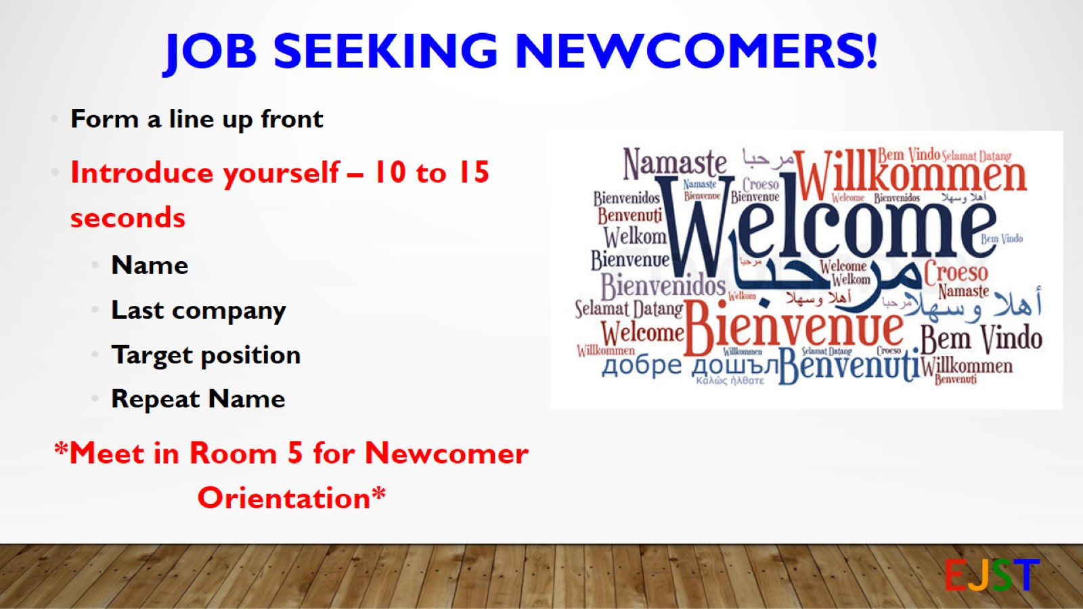
Job Seeking Newcomers!

Slide 10
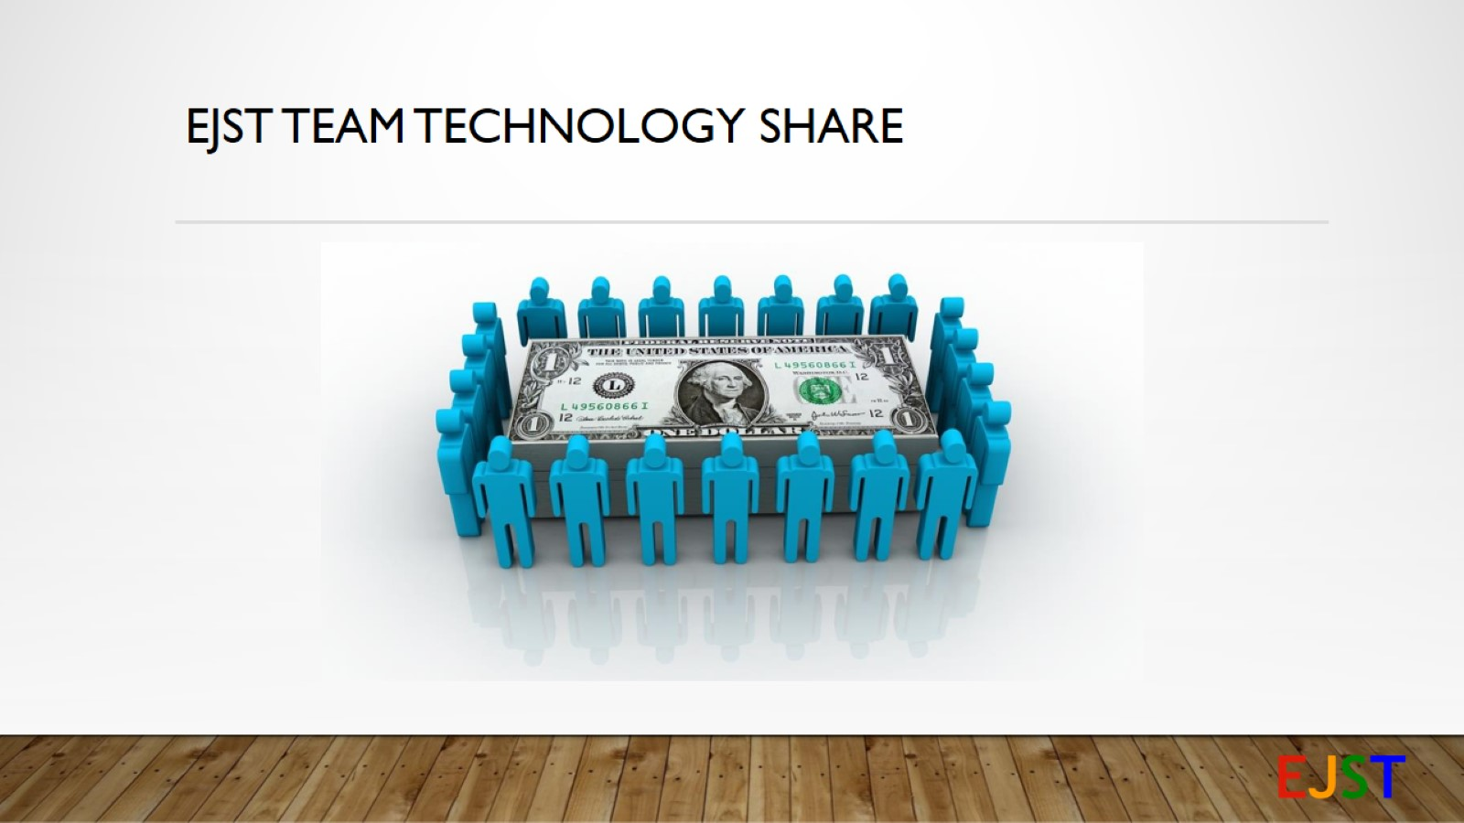
EJST Team Technology Share

Slide 11
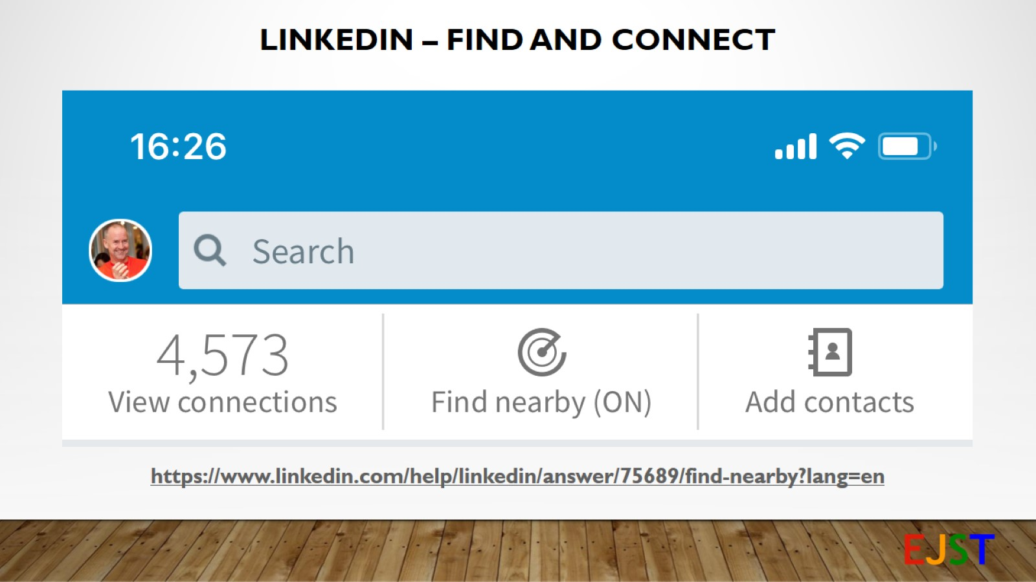
LinkedIn – Find and Connect

Slide 12

Your questions, comments, concerns …

Slide 13
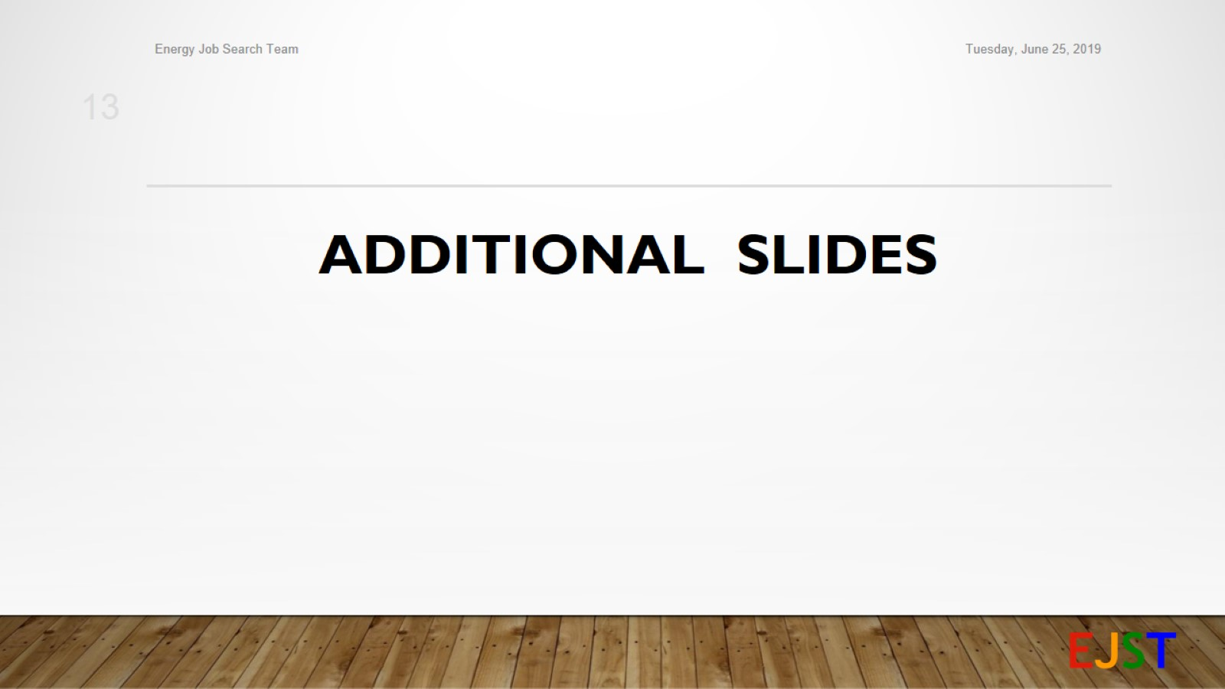
Additional Slides

Slide 14
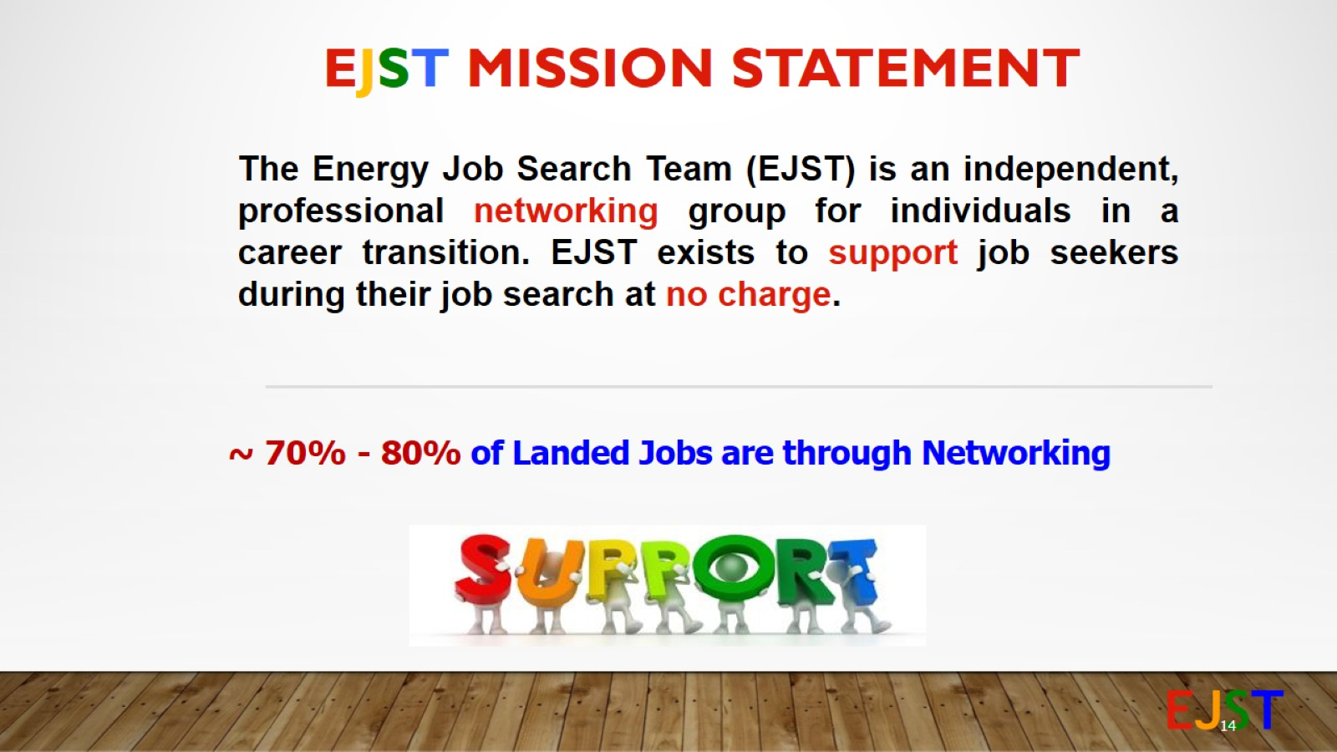
EJST Mission Statement

Slide 15
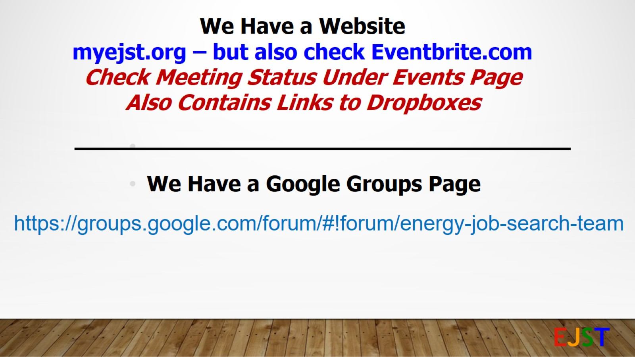

Slide 16

Welcome 2019 – Look to the Future

Slide 17
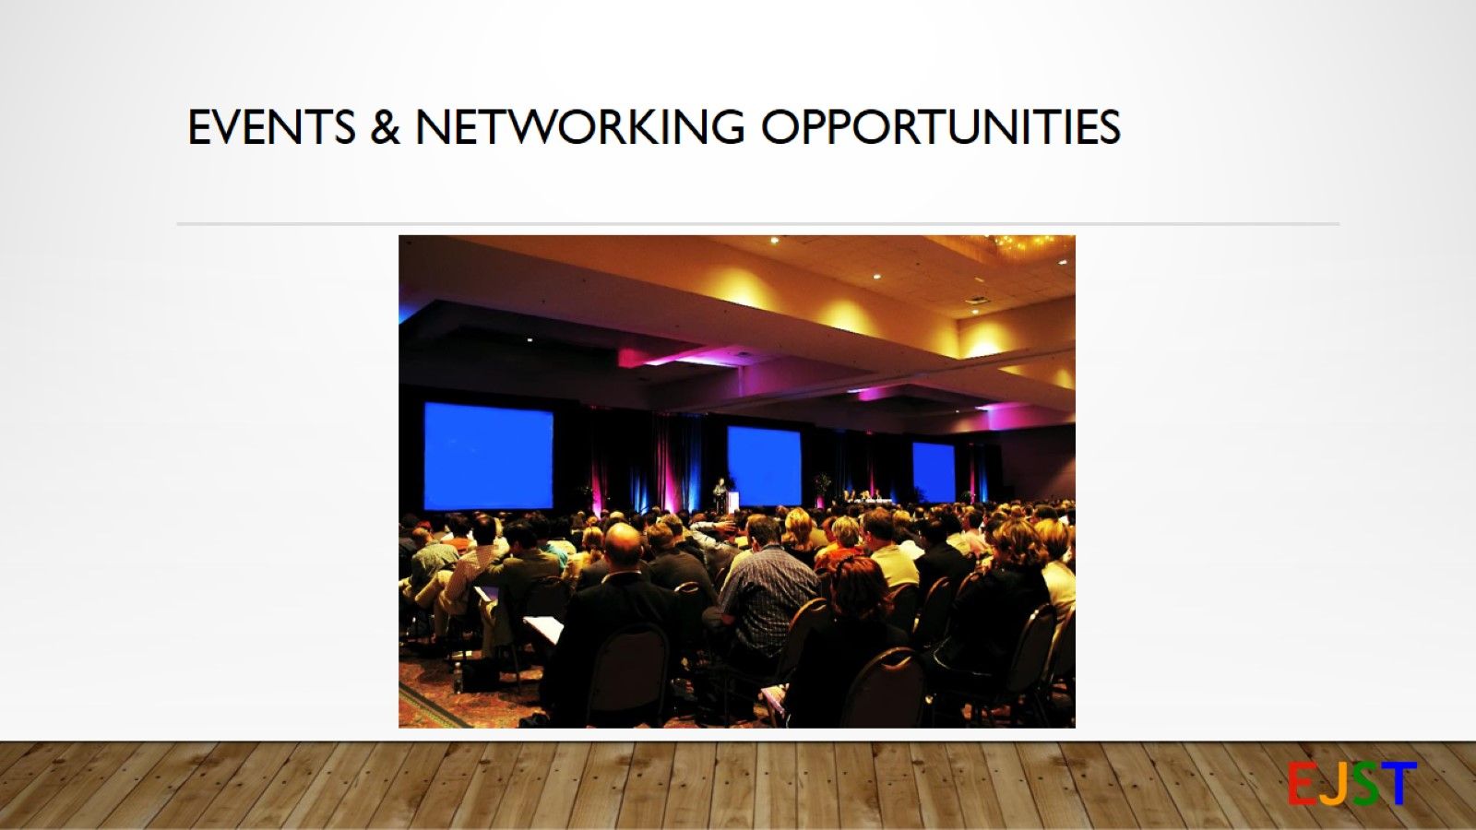
Events & Networking Opportunities

Slide 18
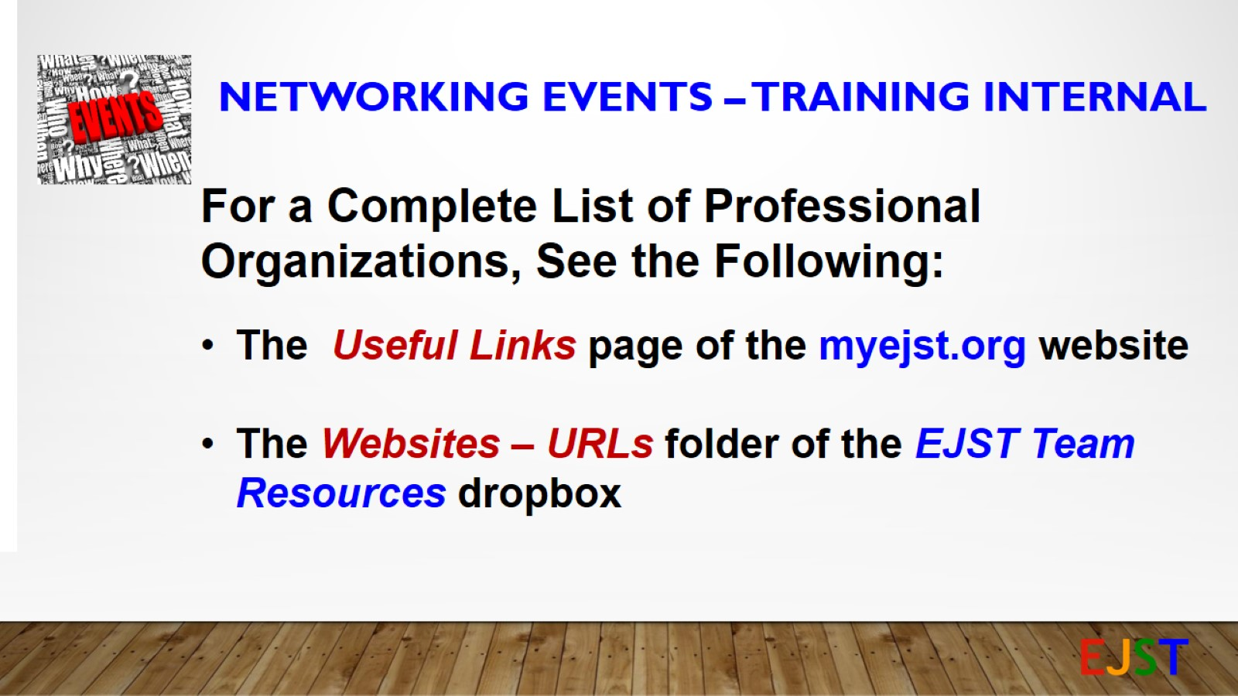
Networking Events – TRAINING INTERNAL

Slide 19
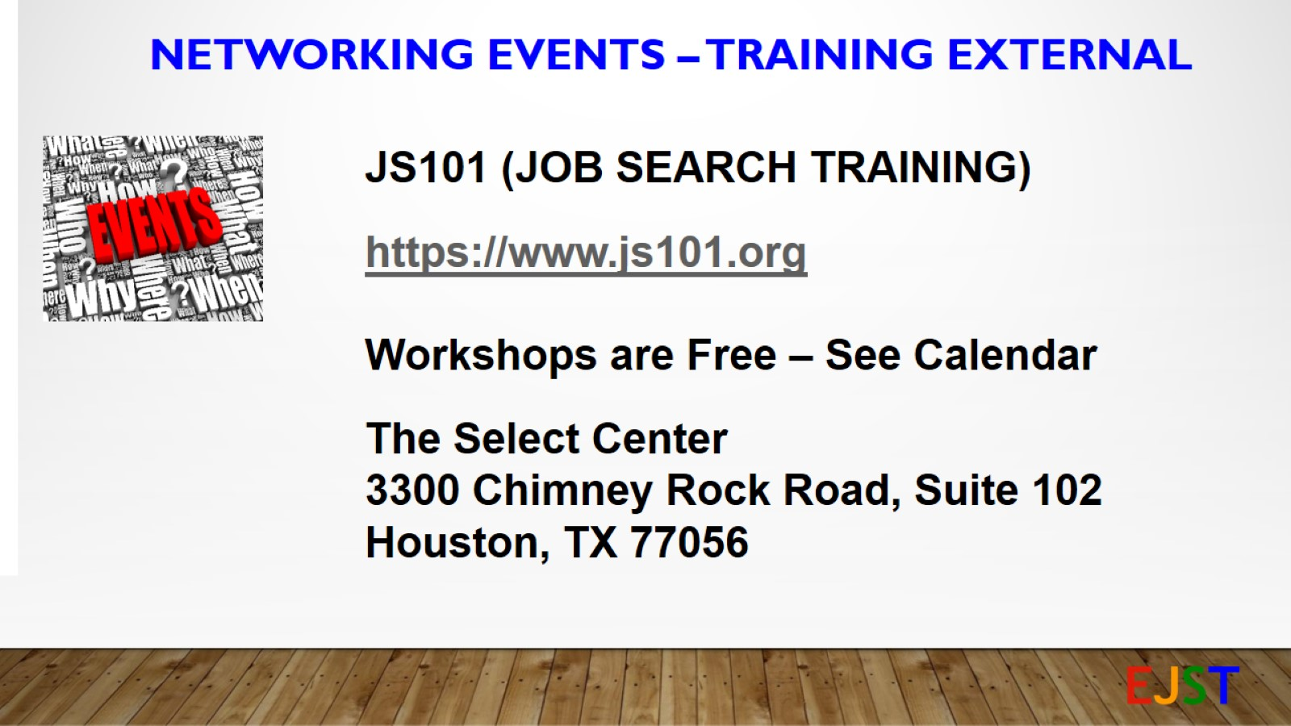
Networking Events – TRAINING EXTERNAL

Slide 20
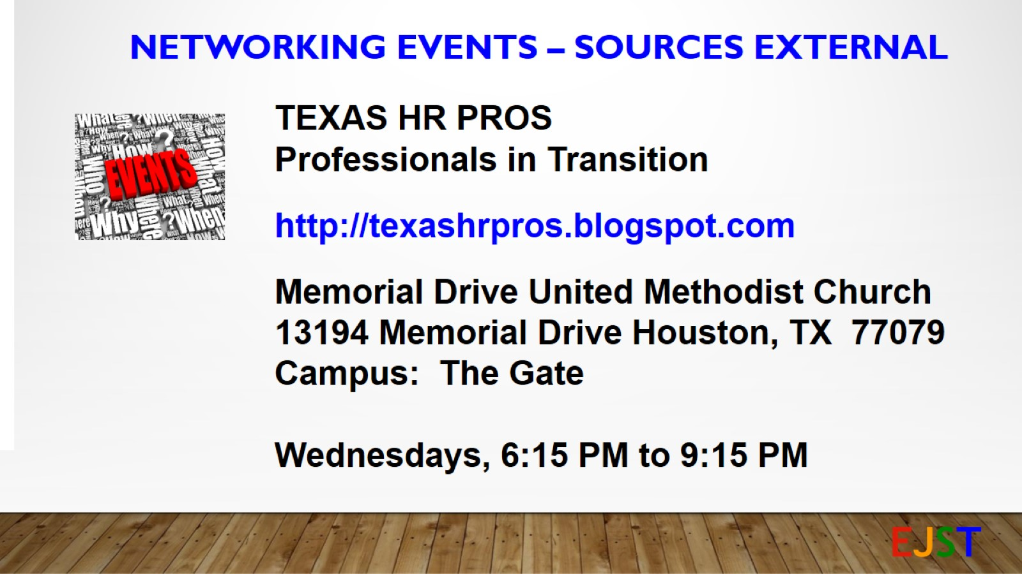
Networking Events – Sources EXTERNAL

Slide 21
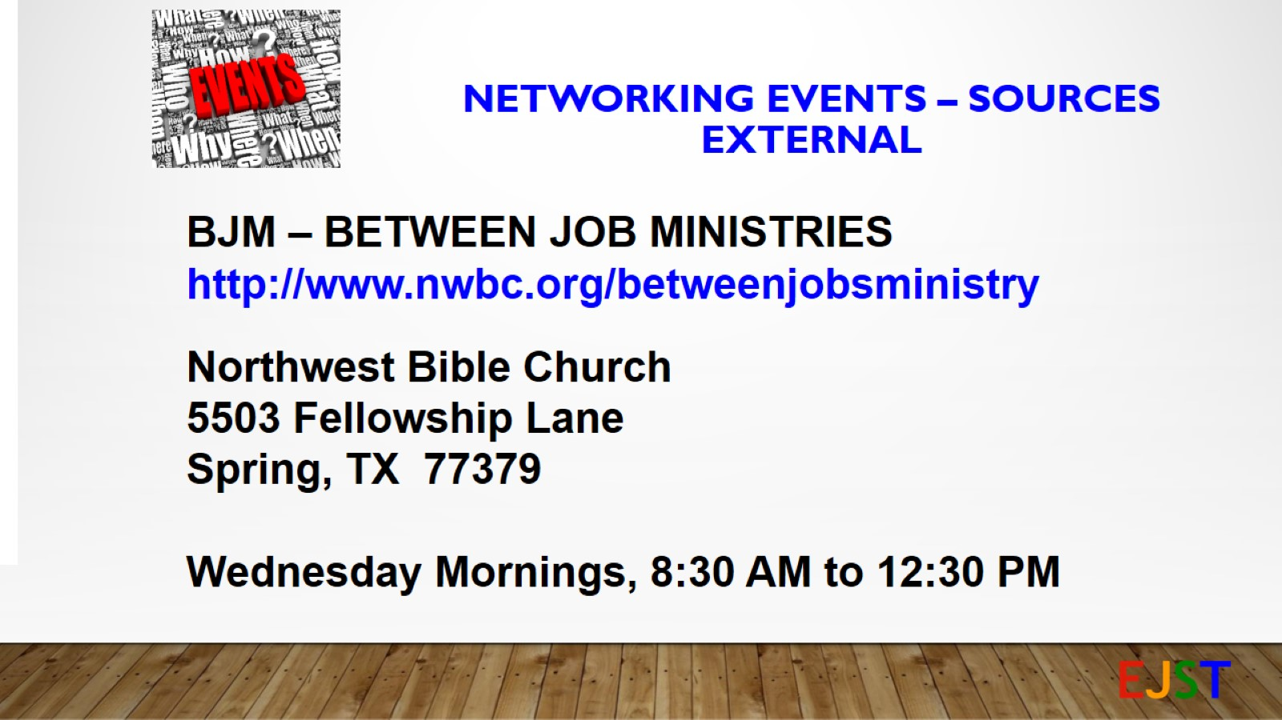
Networking Events – Sources
EXTERNAL

Slide 22
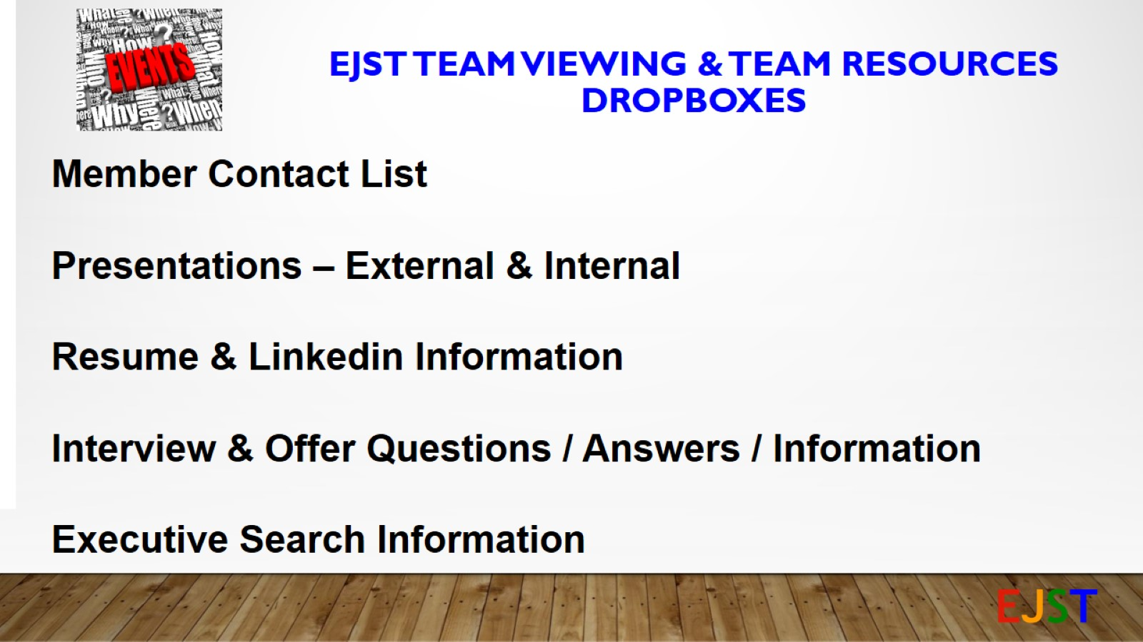
EJST TEAM VIEWING & TEAM RESOURCES DROPBOXES

Slide 23
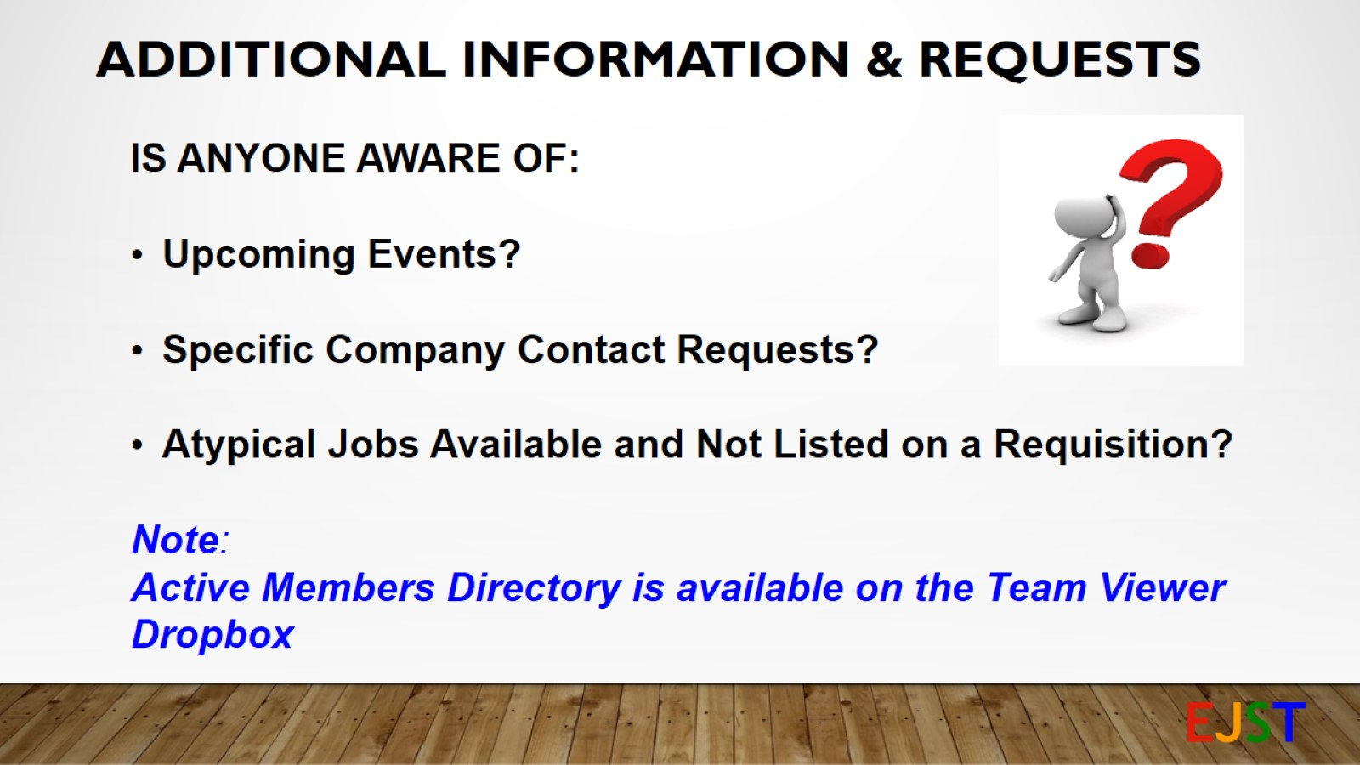
Additional Information & Requests

Slide 24
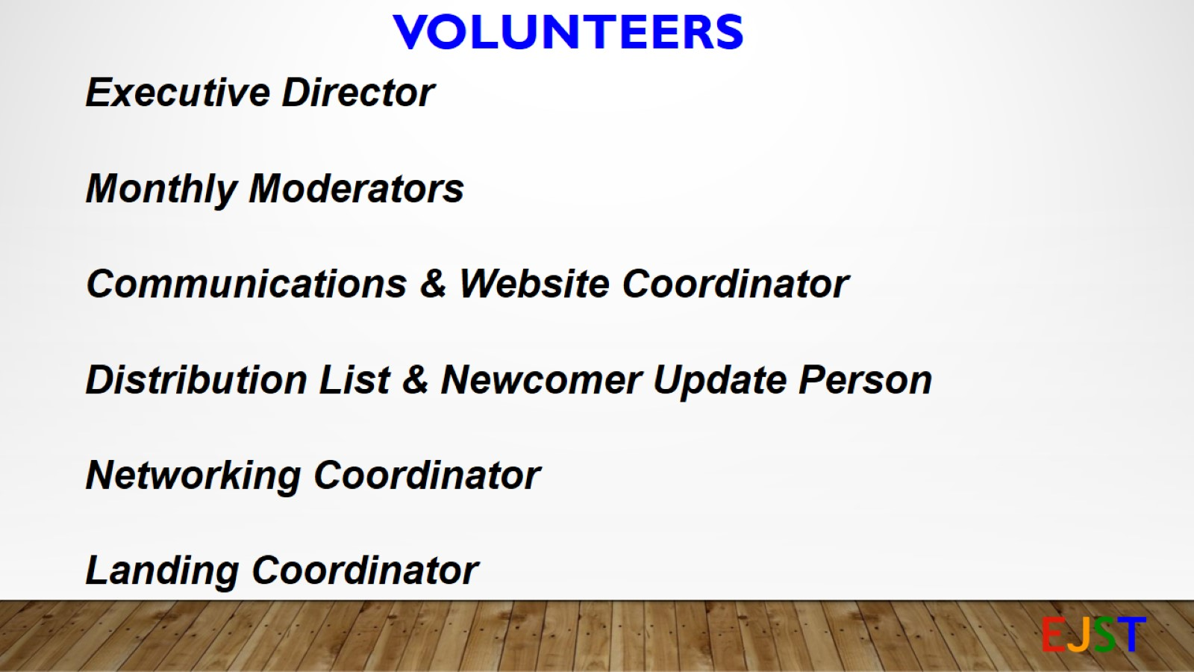
VOLUNTEERS

Slide 25
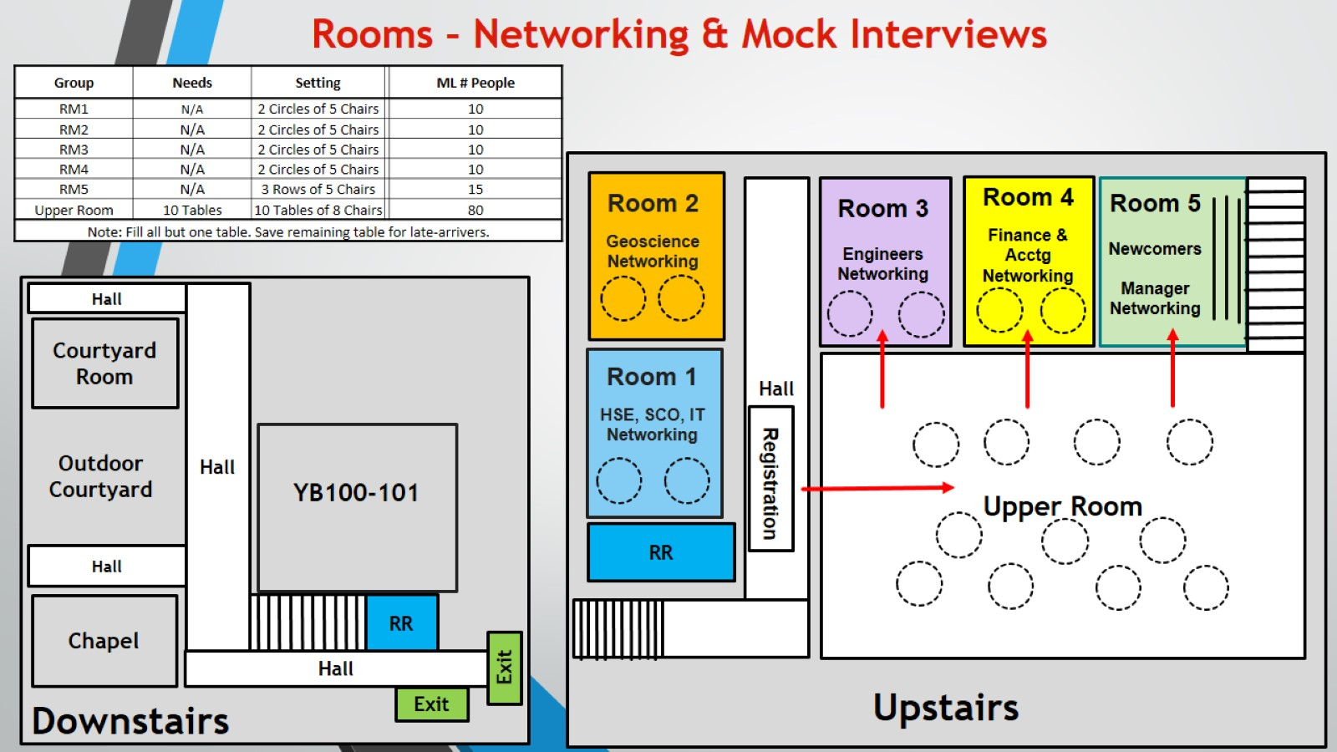
Rooms – Networking & Mock Interviews

