Slide 1
Interview Techniques
Michael Hines, Energy Job Search Team
13th August 2019

Slide 2
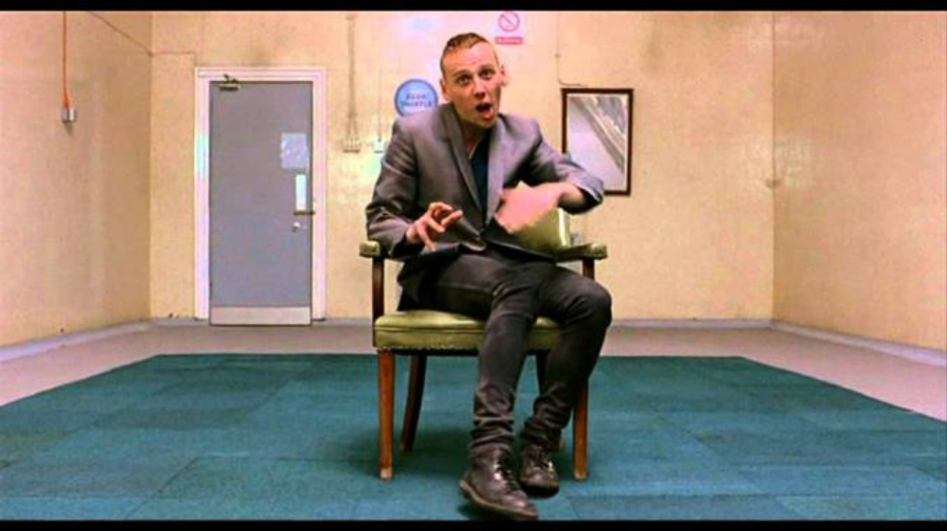
Interview- What is it? A two way conversation !
What are interviewers looking for?
Can you do the job effectively?
Can you demonstrate the skills and experience you say you have?
Will you be able to fit in the Company organization and culture?
Can you do the job with the people here?
Do you have the capacity and ability to grow in the Company?
Any gaps, inconsistencies or red flags?
What is the interviewee looking for?
Is there the right job for me here?
Will this job give me what I am looking for?
Will I fit in with this organization?
Any red flags for me?

Slide 3

Interview Preparation
Research the Company (website, friends, LinkedIn, Glassdoor, etc.)
Study the job description in detail and I have link between your resume and what’s being asked for
Prepare STAR stories around all the key elements of the job description
Self assess before the interview: Personality, Values, Motivation, Strengths
Work out answers to likely questions and practice them!
Deliver a consistent, positive message
Prepare our introductory elevator speech and have good exit questions about the Company
Have a positive attitude showing how you can add value from your skills and experience
Have your highlight talking points to work into the conversation
Listen- answer the question asked while working your angle
Arrive early, Stay Calm, Dress Appropriately
Practice, Practice, Practice!!

Slide 4

STAR Approach – Telling a good story
Why- People like and remember stories !
Use a story to illustrate your experience or achievements!
STAR- Situation, Task, Action, Results
Situation- Briefly summarize the technical or business situation
Task- What needed to be done or achieved
Action- What action did you do to achieve the result
Results- What happened as a result of your action (Don’t forget this)

Slide 5
Different types of Interviews
Face-To-Face: The classic interview we will practice today
Panel interview: Similar to one-on-one. Talk the questioner, but keep eye contact to others
Telephone or video interview: Dress as per a face-to-face interview, have a good connection, do in a nice, quiet room, no distractions, smile, project positivity and energy
General management & HR-type interviews we will practice today. However there are often detailed technical interviews (e.g. drilling specialty) that we will not do today.

Slide 6
Difficult, negative questions in Interviews
You will get negative questions- Live with It. Don’t be defensive about them (e.g. Tell me a weakness?: I have NONE is a bad answer)
Acknowledge the question
You don’t have to pick the worst situation you had and pick something less critical to the job
Suggest a weakness that is not a weakness from the Company’s position
Suggest something from your past
Show how you have improved on it now and learned from the experience through training, experience or mentorship
Show and tell how you learned from the experience and a better, more skilled team member now.
Spin it positively !
If you get an “illegal question”, personally I answer it- unless deeply offensive. We will practice this in the mock questions.

Slide 7
Interview Skills & Tips
Attitude: Get a positive, confident attitude
Have the mindset “This interview will go well because I know I can add value to this Company by utilizing my valuable skills and experience”
Do your homework on the Job, Company, Company terminology and Interviewers
Follow-up questions- follow up an answer with a question or remark to bring out your taking points and STAR stories
Listen to the question & answer authentically
Keep answers focused and don’t ramble. Take ques from your interviewer about when to move on. Answer your best part first.
Maintain good eye contact, handshake and body language
Conclude the interview with your pitch & ask about next steps
Send thank you notes within 24 hours to all interviewers

Slide 8
Caveman Hunter-Gatherer Interview
https://youtu.be/b56eAUCTLok

Slide 9
Mock Interview Practice sessions
We have six sets of typical mock interview questions typical for oil-industry professional interviews, each with about 10 questions
Please split into small teams of 3 people. You will each act as interviewer, interviewee and Observer/Time-Keeper. Spread out around the room.
I will hand out a package of 4 sheets to each team. There are 3 sheets of different questions and take one of these each.
Please do not show to your questions to your team members. The 4th sheet is guidelines for the Observer to monitor during the interview
The interviewer should ask the questions on their sheet to the interviewee for about 15-20 mins, monitored by the observer. Then have about 5 mins of feedback from the observer & interviewer.
The observer should read the next resume when the interviewer/interviewee are talking and be the next interviewer of the resume they have just read. Try to integrate the written questions and the resume.
After the initial round, change the roles of interviewer, interviewee & observer around and repeat twice more so each person does each role once.
When Questions ask about a “Company”, talk about your target Company.

